Slide 1
@Ju_Pichon
@FdvJulie
@FranckPrts
+
-
Archaea &
ohmmeter
BACTERUINO

Slide 2
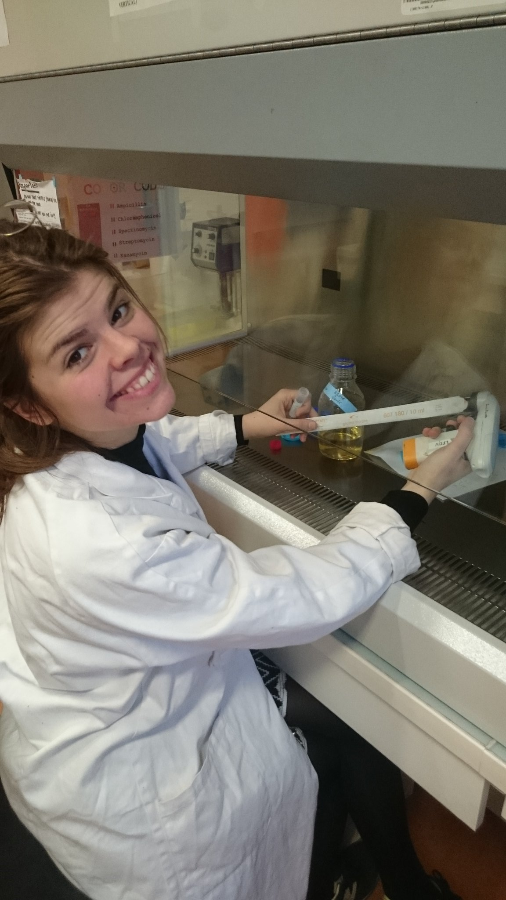
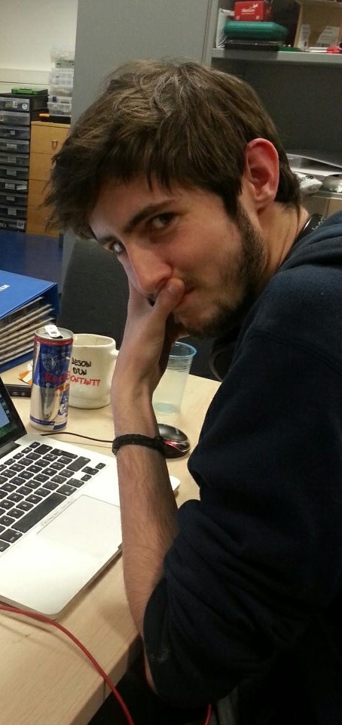
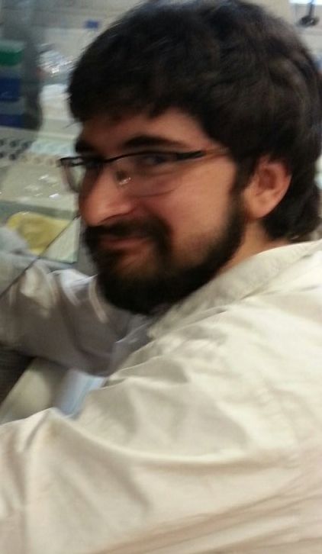
To sum up this week...
3 motivated students
Halobacterium which are actually not bacteria…
An Arduino sensor without a sensor
40 000 data to analyze (thanks TecanInfinity)
Archaea which make a colony in 7 days

Slide 3
Why did we choose these sensors?
Halobacterium
DIY Ohmmeter
Extremophilic archaea → Can live in high salted-media
Growth rate depends of the concentration of salt in the media
So we can link growth rate with conductivity
Have a range of 0.1M to 5.1M
Easy and fast to build
Need little material
Analog to digital data
Can give to us the conductivity

Slide 4
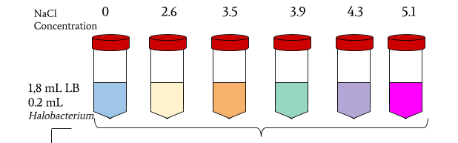
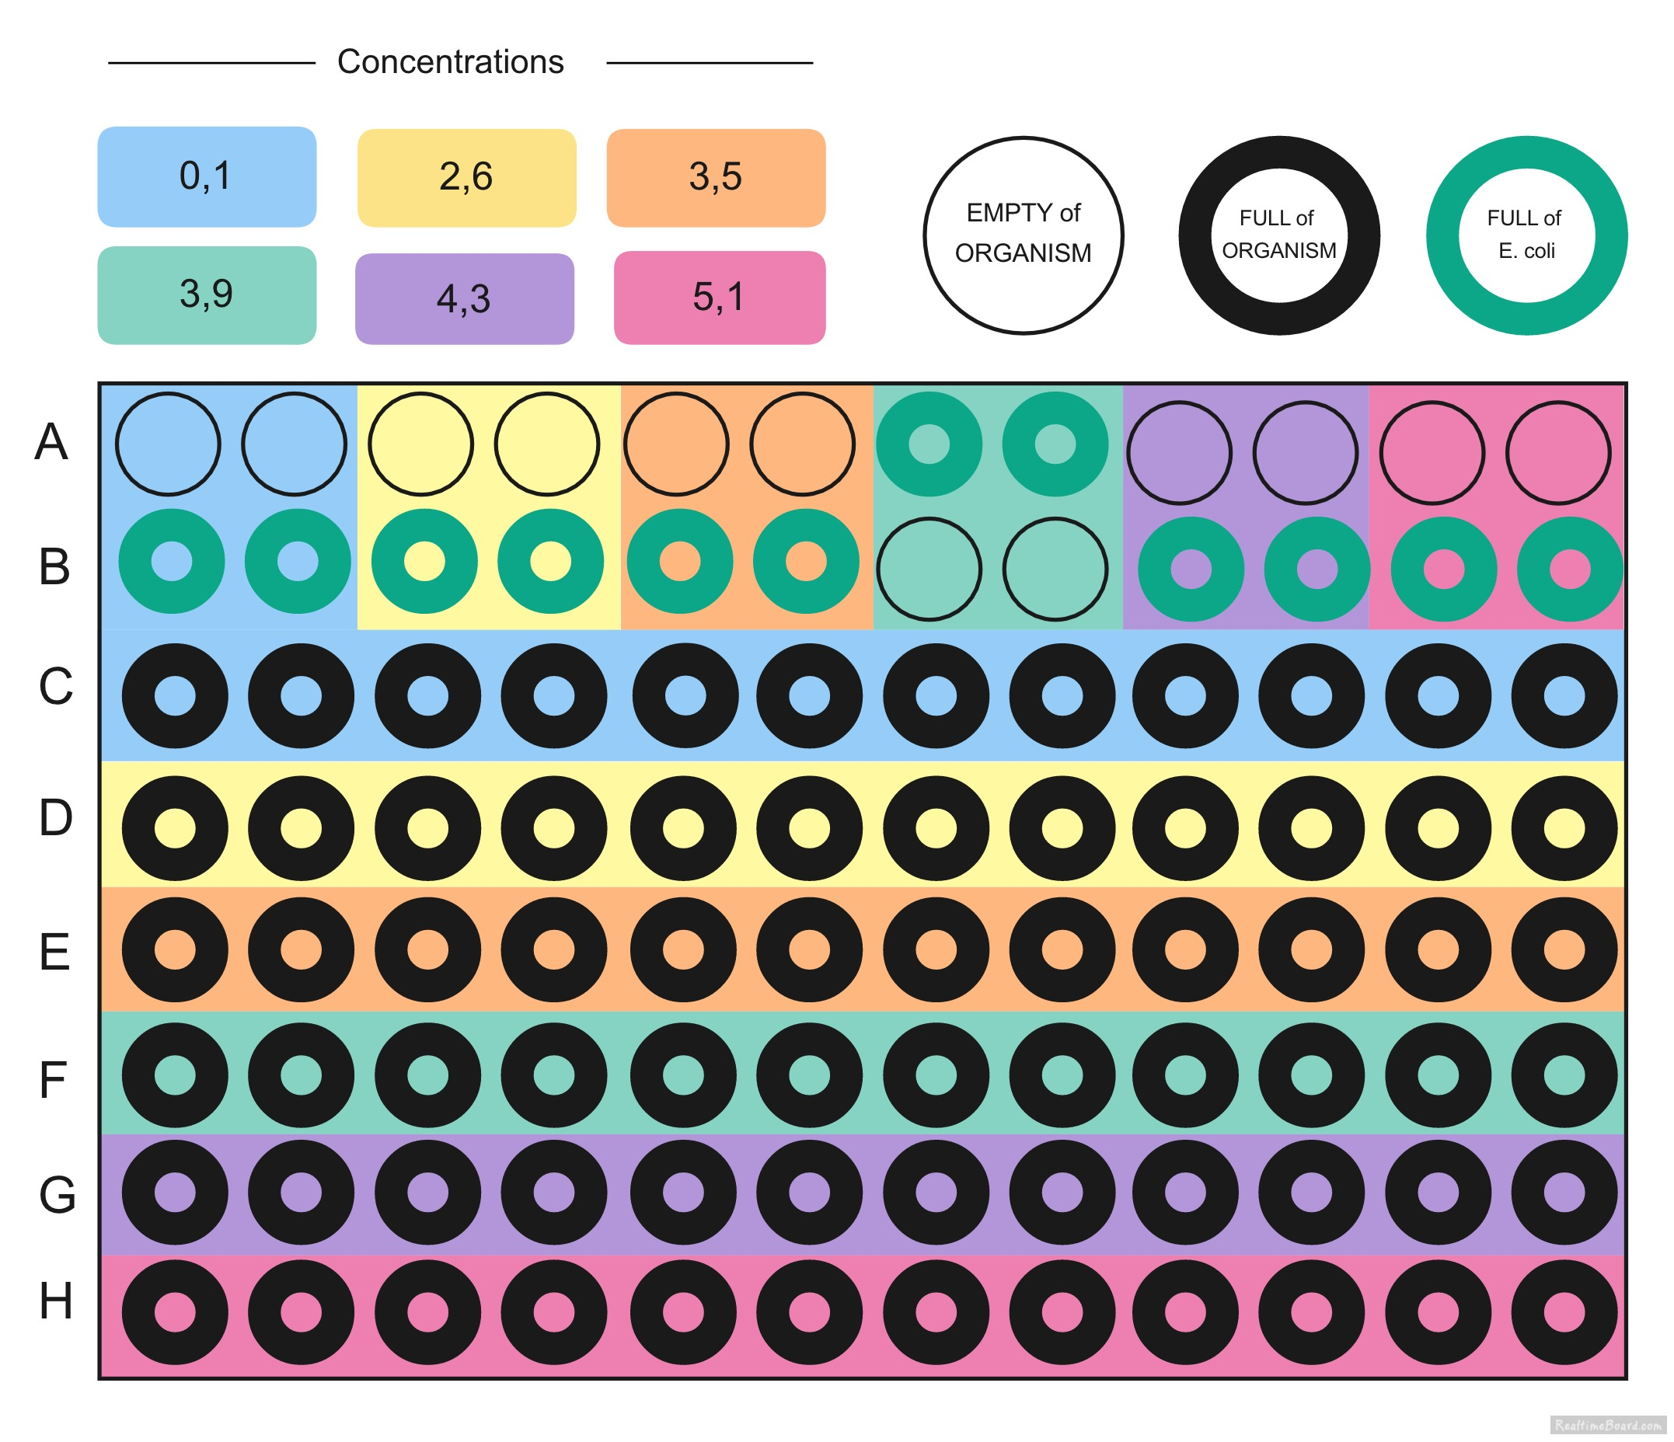
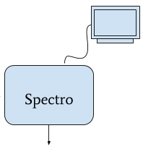
Protocol for Halobacterium
24 hours

Slide 5
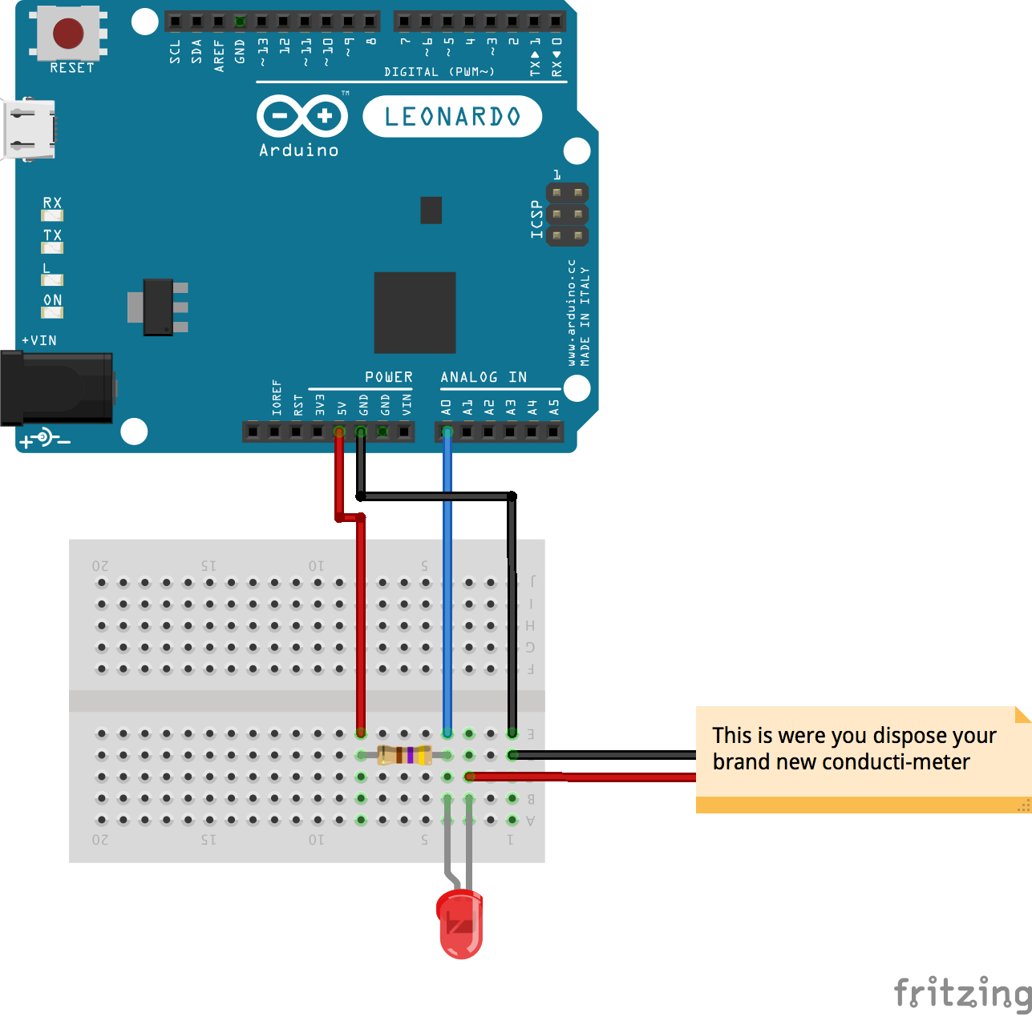
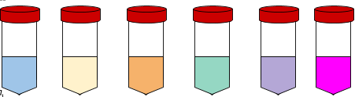
Protocol for electronic sensor
0 2.6 3.5 3.9 4.3 5.1
+

Slide 6
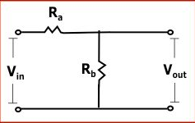
In the real life
Voltage Divider Calculator :
Rb = Ra * (Vin - Vout)/Vout
Ra = 470Ω
Vin = 5V
Vout = Arduino measurement

Slide 7
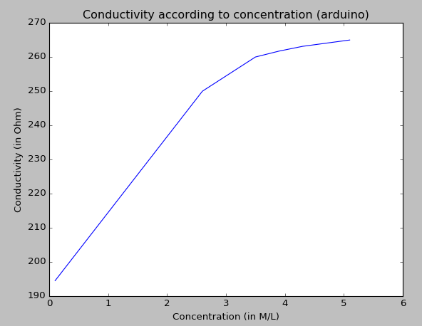
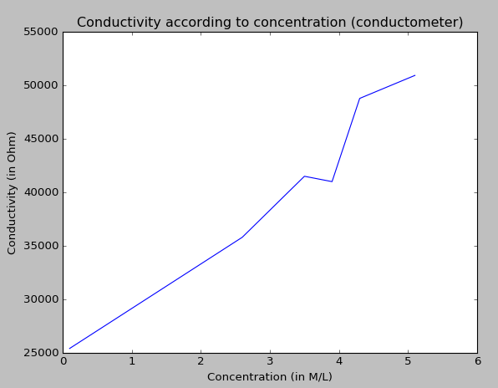
Results of electronic sensor

Slide 8
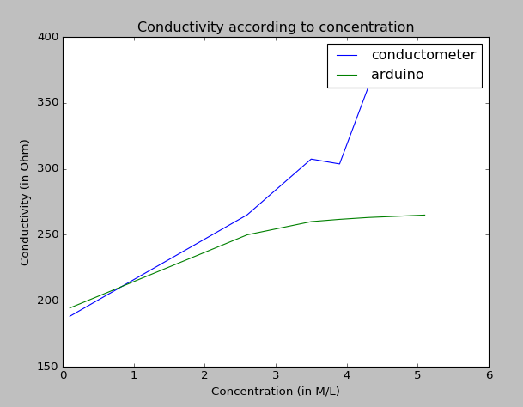
Results of arduino compared to ohmmeter
Saturation at 2.6 M/L for arduino
Some bias with ohmmeter:
Not have the same distance between the 2 electrodes
Not immersed the 2 electrodes in the same volume

Slide 9
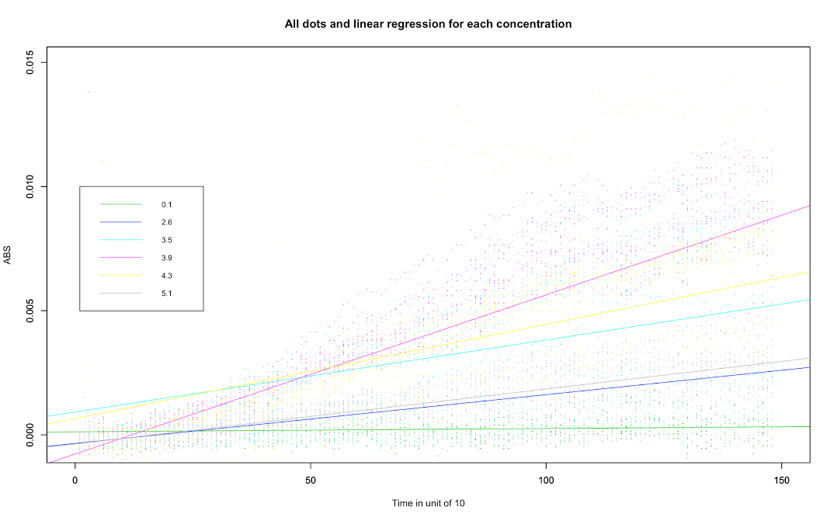

Slide 10
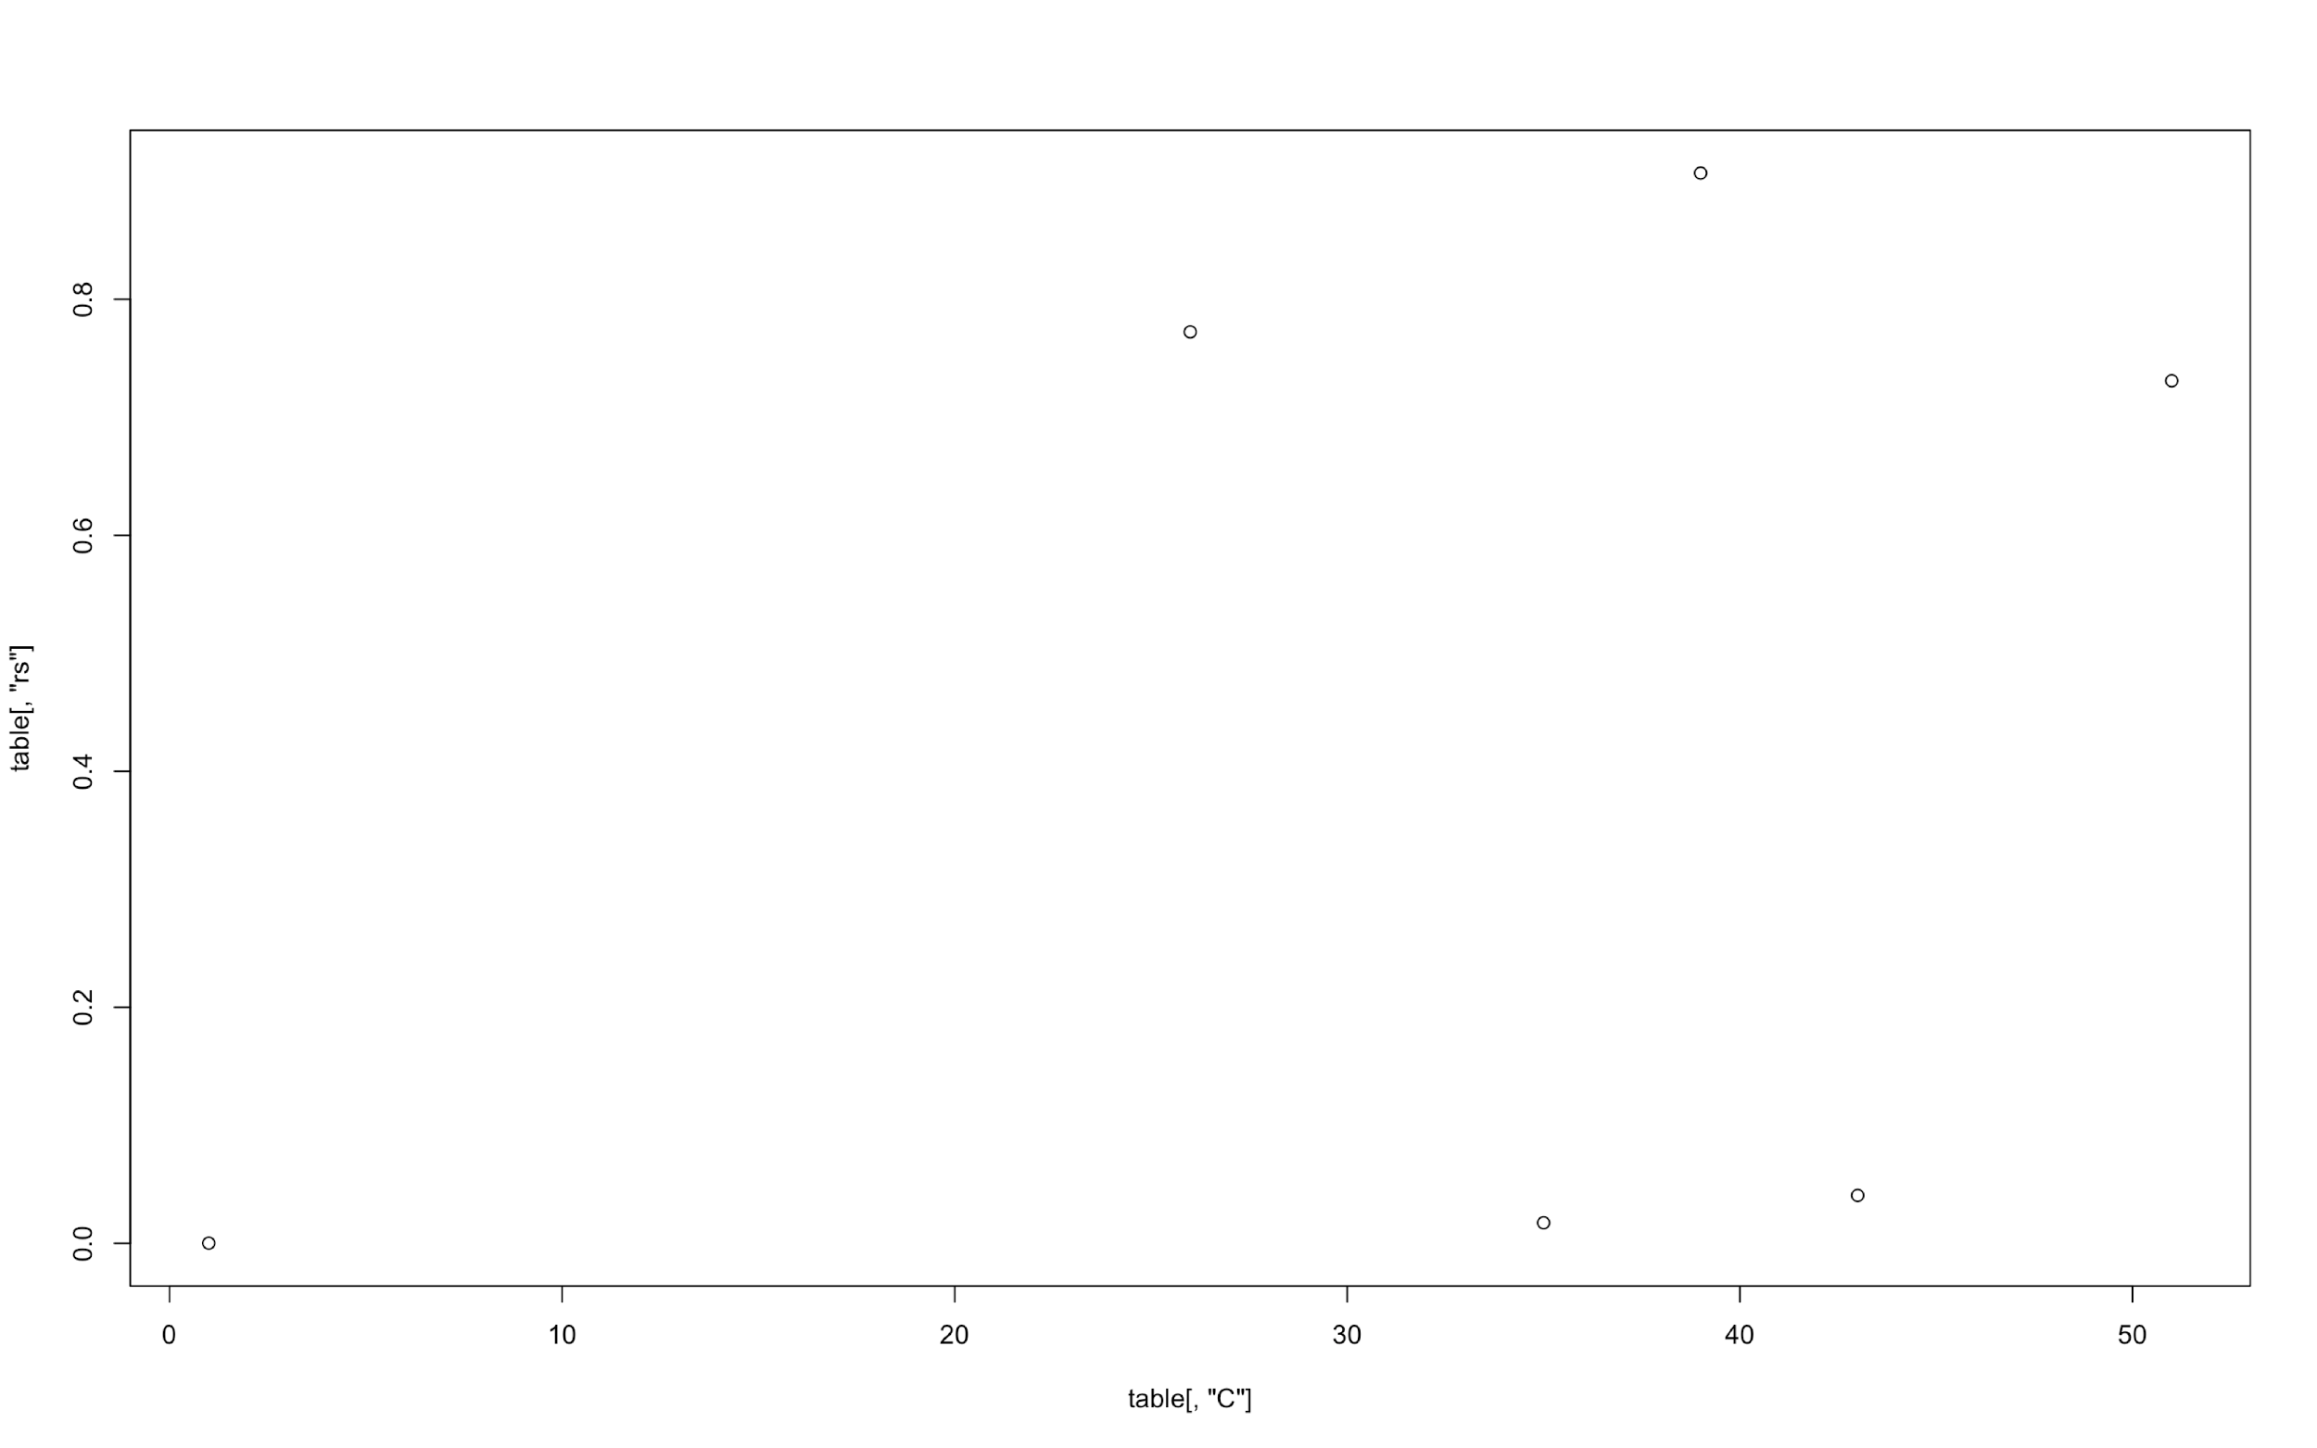
R² for each concentration

Slide 11
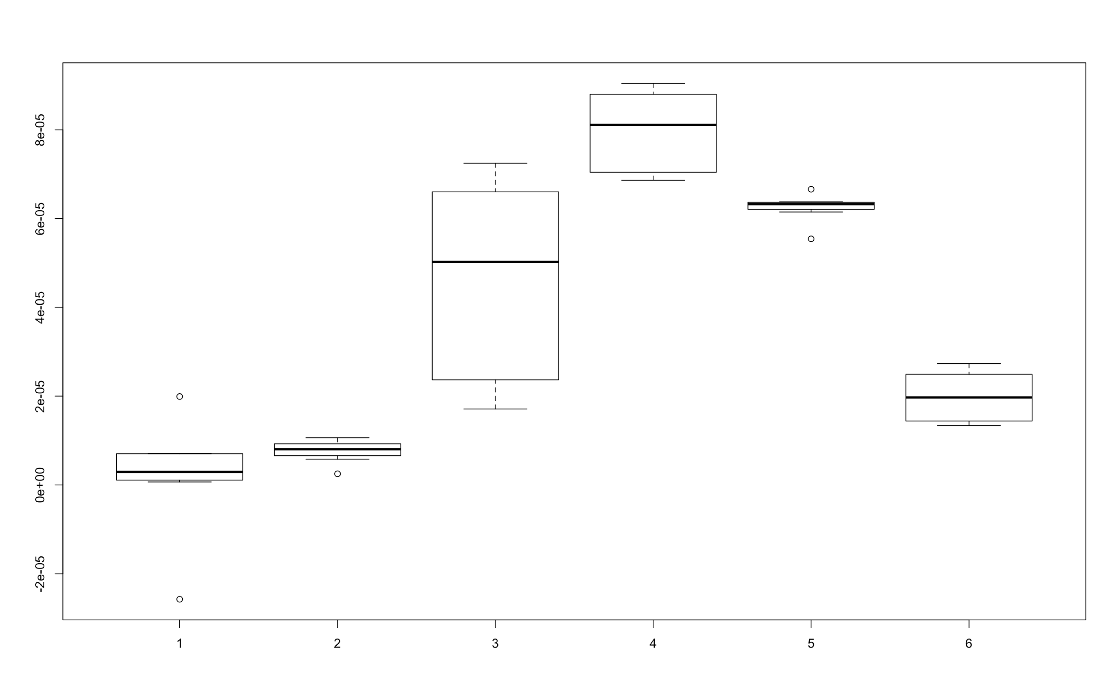

Slide 12
Bibliography
Leuko, Stefan, Mark J. Raftery, Brendan P. Burns, Malcolm R. Walter, et Brett A. Neilan. « Global Protein-Level Responses of Halobacterium Salinarum NRC-1 to Prolonged Changes in External Sodium Chloride Concentrations ». Journal of Proteome Research 8, nº 5 (mai 2009): 2218‑25. doi:10.1021/pr800663c.
« Halohandbook_2008_v7 - Halohandbook_2008_v7.pdf ». Consulté le 25 janvier 2017. http://www.haloarchaea.com/resources/halohandbook/Halohandbook_2008_v7.pdf.
Kish, Adrienne, Patrick L. Griffin, Karyn L. Rogers, Marilyn L. Fogel, Russell J. Hemley, et Andrew Steele. « High-Pressure Tolerance in Halobacterium Salinarum NRC-1 and Other Non-Piezophilic Prokaryotes ». Extremophiles: Life Under Extreme Conditions 16, nº 2 (mars 2012): 355‑61. doi:10.1007/s00792-011-0418-8.

Slide 13

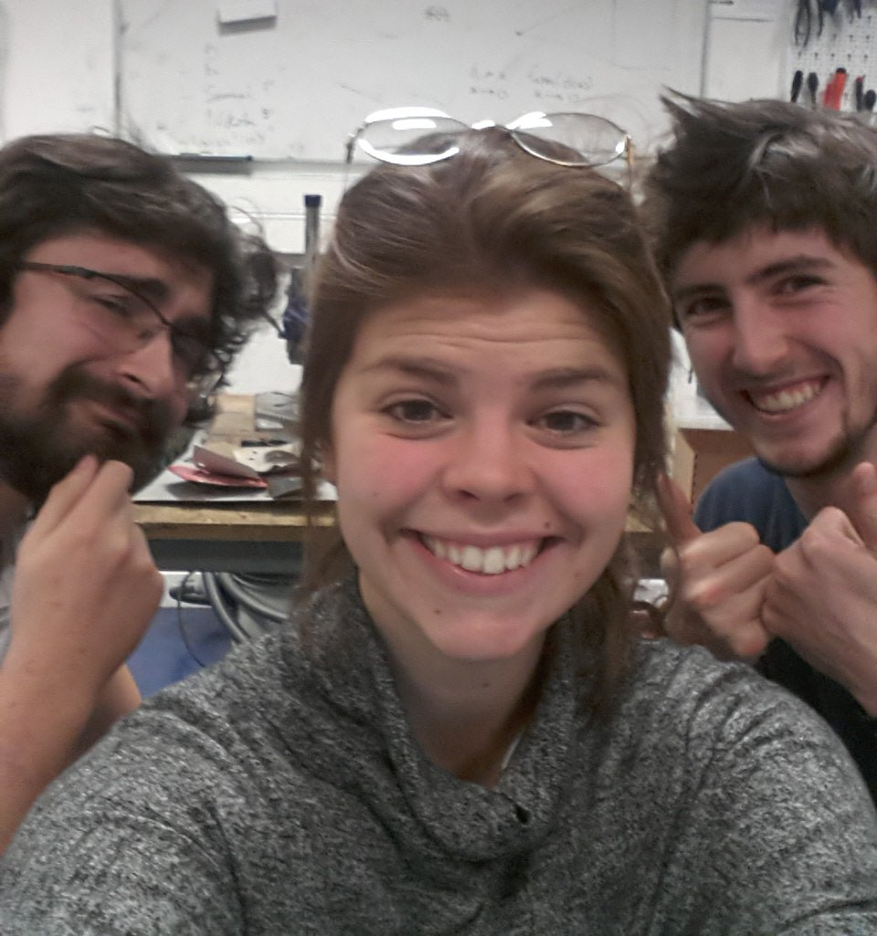


Thank you !

